Slide 1


Slide 2
Defined & Problem Statement
This dataset is used to predict Employee attrition is the naturally occurring, voluntary departure of employees from a company. leaving a job for about the Employee
In this project, we attempt to bridge the gap by providing a systematic analysis of the various employee records for the purpose of Attrition
* Personal reasons
* Professional motivation
* Job mismatch
* Issues in the workplace

Slide 3
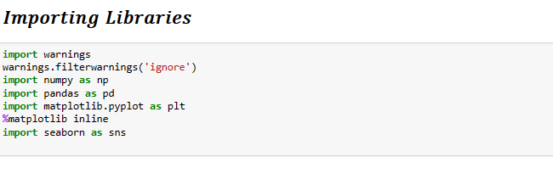
IMPORT LIBRARIES
INSIDES OR VERIABLES
* Age
* Daily Rate
* Distance From Home
* Environment Satisfaction
* Hourly Rate
* Job Involvement
* Job Level
* Job Satisfaction
* Monthly Rate
* Percent Salary Hike
* Relationship Satisfaction
* Total Working Years
* Work Life Balance
* Years At Company
* Years In Current Role
* Monthly Income
* Attrition
* BusinessTravel
* Department
* EducationField
* Gender
* JobRole
* MaritalStatus
* OverTime

Slide 4
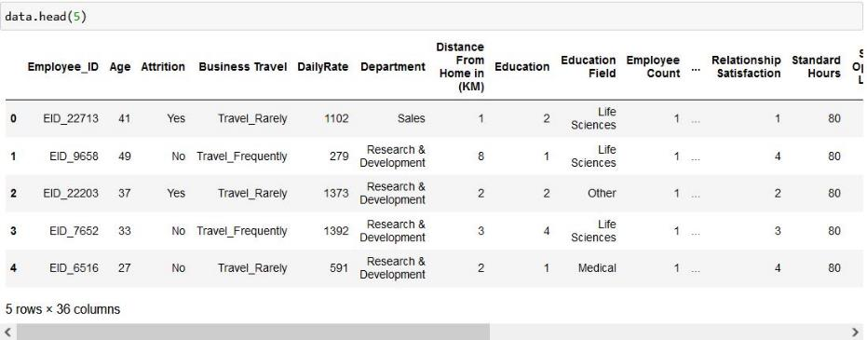


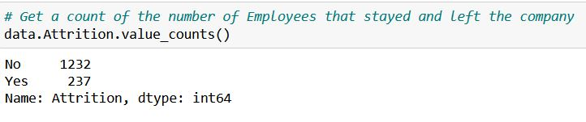
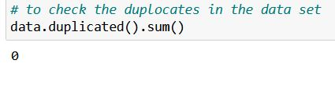
Exploratory Data
Displaying Row & Columns
Checking Null Values & Duplicate

Slide 5
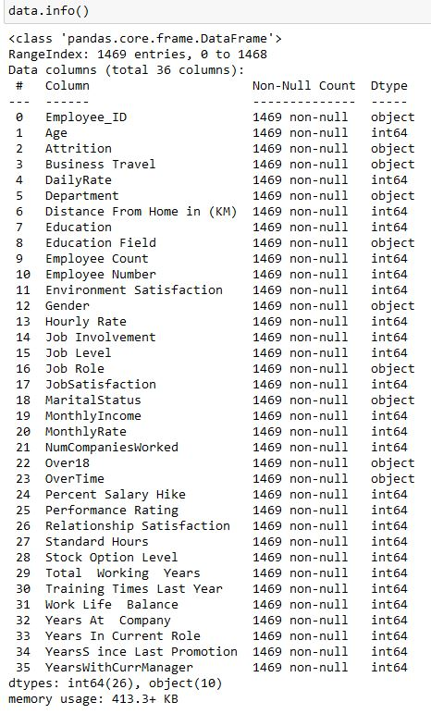
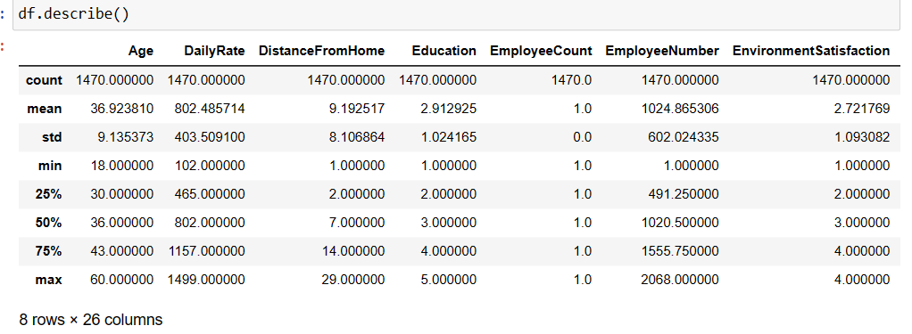
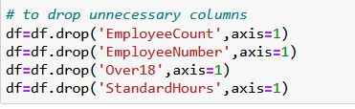
Statistical Information
Dropping Non-Relevant Variables

Slide 6

EDA Exploratory Data Analytics

Slide 7
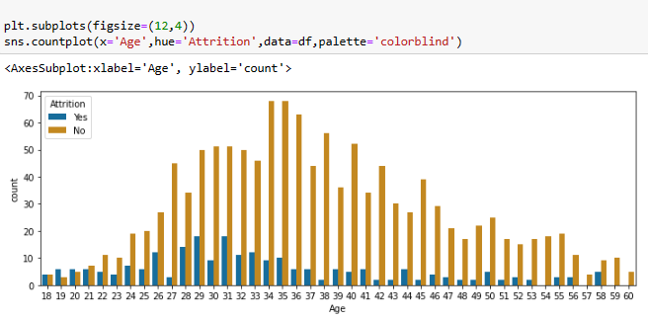
EDA (Visualization)
we can observe that the number of employees leaving the company tends to be higher in the younger age groups, with the highest attrition rates being in the age group between 29 and 31 years. The number of employees leaving the company gradually decreases as age increases, with the lowest attrition rates being in the age group between 54 and 60 years.

Slide 8
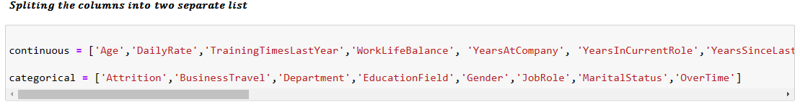
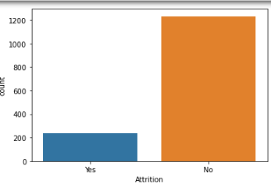
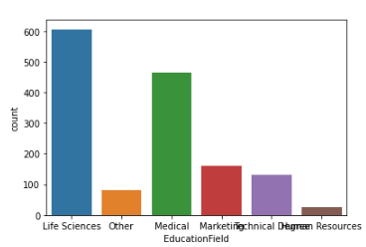
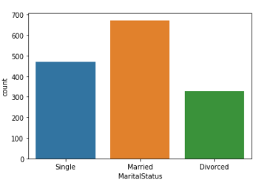
Splitting Columns Categorical And Continuous Variable
EDA- COUNT PLOT

Slide 9
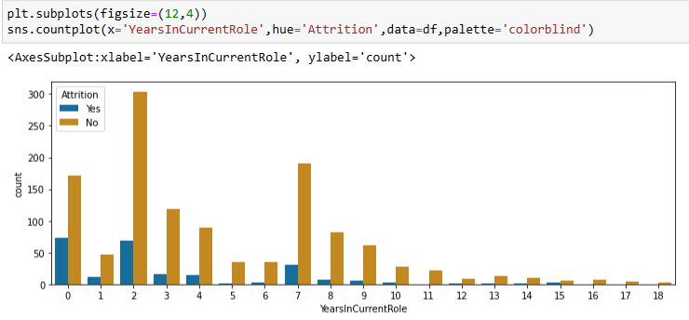
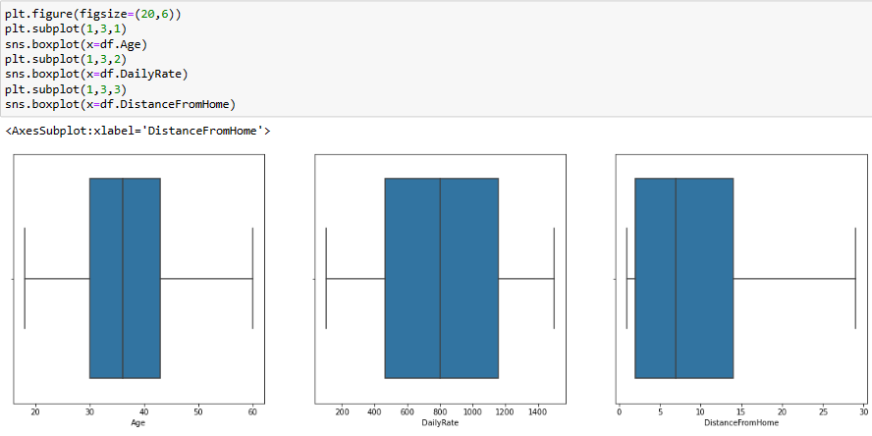
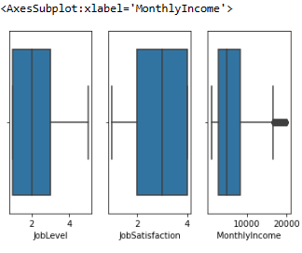
Attrition V/s Years in current Role
In Count Plot we can see employee working in organization in Current Role more Attrition and Also Box plot we can see high attrition in monthly income and Job satisfaction ,Distance From Home
Attrition V/S Distance From Home and Monthly Income Use BOX PLOT

Slide 10
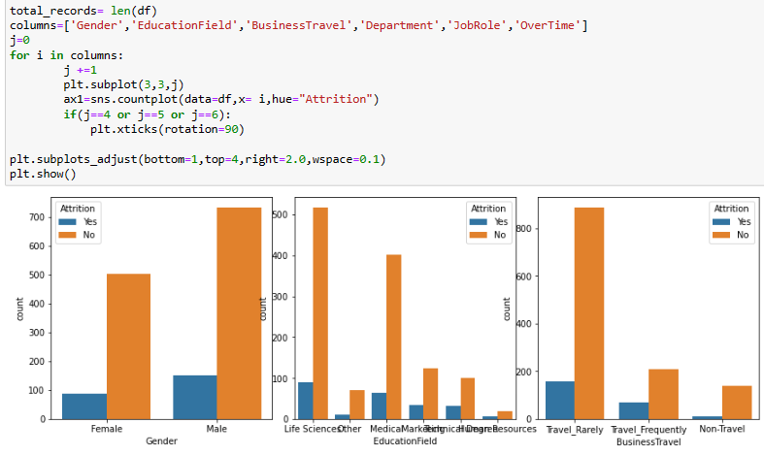
EDA - SUBPLOTS GRAPHS
Gender vs. Attrition:
* Male: 83% of employees have not left the company, 17% have left
* Female: 85% of employees have not left the company, 15% have left
Business Travel vs. Attrition:
* Non-Travel: 92% of employees have not left the company, 8% have left
* Travel_Rarely: 85% of employees have not left the company, 15% have left
* Travel_Frequently: 73% of employees have not left the company, 27% have left

Slide 11
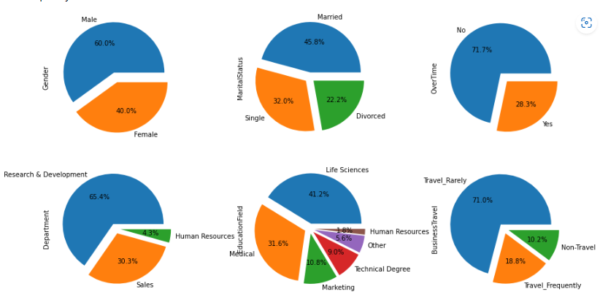
EDA - PIE PLOTS
Education Field vs. Attrition:
* Life Sciences: 85% of employees have not left the company, 15% have left
* Medical: 86% of employees have not left the company, 14% have left
* Marketing: 76% of employees have not left the company, 24% have left
* Technical Degree: 75% of employees have not left the company, 25% have left

Slide 12
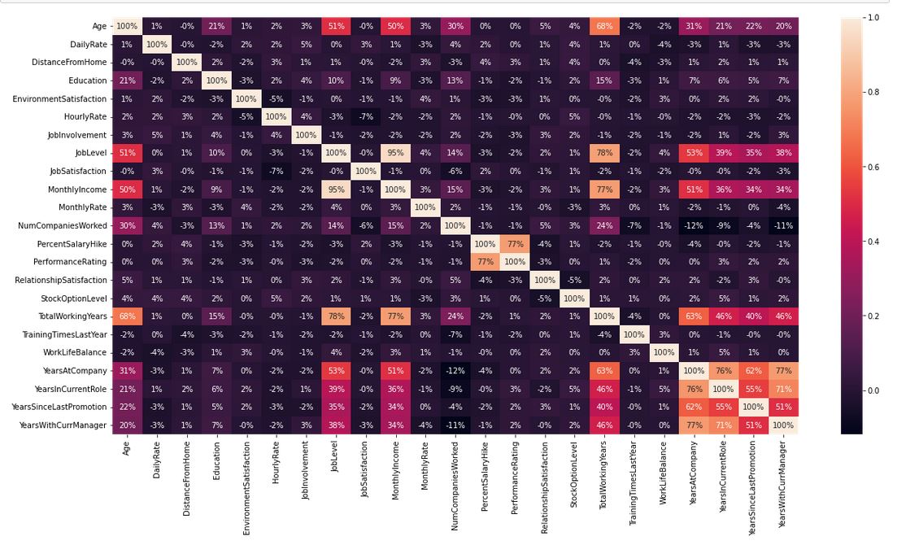
EDA - HEATMAP
Correlation between Monthly Income and Job Level is 0.95. This is a very high correlation.
Correlation between Total Working Years and Job Level is 0.78 which is also very close to 0.80.
Correlation between Total Working Years and Monthly Income is 0.77 which is also very close to 0.80.
Correlation between Years At company and YearsAtcompanyManager is 0.77 which is also very close to 0.80.
All other variables seem to have a correlation which is less than 0.80

Slide 13

Machine Learning Models

Slide 14
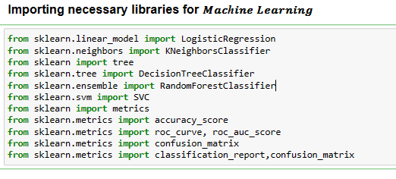
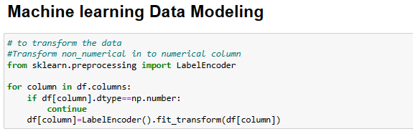
IMPORTING LIBRARIES MACHINE LEARNING

Slide 15
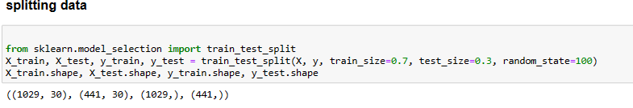
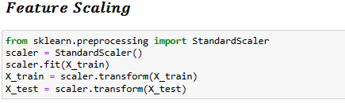
Splitting Dataset
The training data is randomly chosen 1,029 (70%) instances, 172 represents attrited employees, 857 did not attrited.
The test data is the remaining 441 (30%) instances, 65 represents attrited employees, 376 employees that did not attrited.

Slide 16
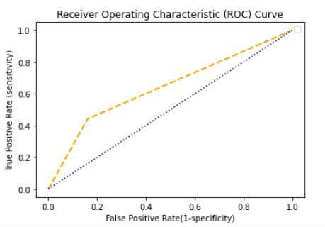
Decision Tree
Library used : sklearn.tree (DecisionTreeClassifier)
Split used for training and testing the data : 70-30
Feature Scaling was performed after splitting the dataset to avoid information leakage on testing dataset by using Standardization method.
Accuracy : 77%
Recall : 0 - 88 %, 1 – 100 %
Precision : 0 – 100 %, 1 – 83%

Slide 17
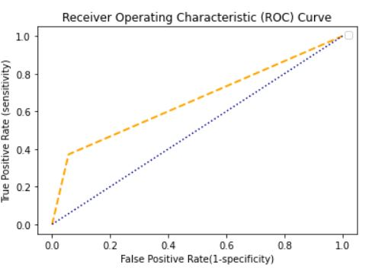
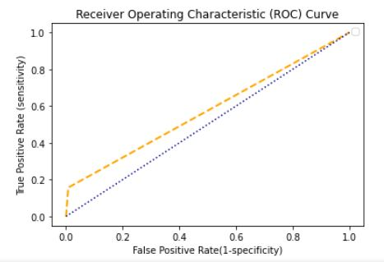
Random Forest
Logistic Regression
Library used : sklearn.ensemble (RandomForestClassifier)
Split used for training and testing the data : 70-30
Feature Scaling was performed after splitting the dataset to avoid information leakage on testing dataset by using Standardization method.
Accuracy : 85%
Recall : 0 - 85%, 1 – 100 %
Precision : 0 – 100 %, 1 – 99%
Library used : sklearn.linear_model (LogisticRegression)
Split used for training and testing the data : 70-30
Feature Scaling was performed after splitting the dataset to avoid information leakage on testing dataset by using Standardization method.
Accuracy : 84%
Recall : 0 -85%, 1 – 83 %
Precision : 0 – 97 %, 1 – 100%

Slide 18
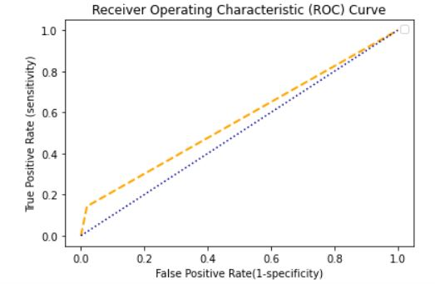
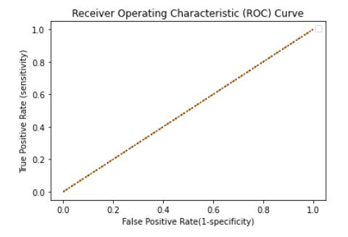
KNN
SVM
Library used : sklearn.neighbors (KNeighborsClassifier)
Split used for training and testing the data : 70-30
Feature Scaling was performed after splitting the dataset to avoid information leakage on testing dataset by using Standardization method.
Accuracy : 80%
Recall : 0 - 84 %, 1 – 100 %
Precision : 0 – 100 %, 1 – 94 %
Library used : sklearn.svm (SVC)
Split used for training and testing the data : 70-30
Feature Scaling was performed after splitting the dataset to avoid information leakage on testing dataset by using Standardization method.
Kernel = ‘rbf’ ,
Accuracy : 86%
Recall : 0 - 87 %, 1 – 100 %
Precision : 0 – 100 %, 1 – 98 %

Slide 19
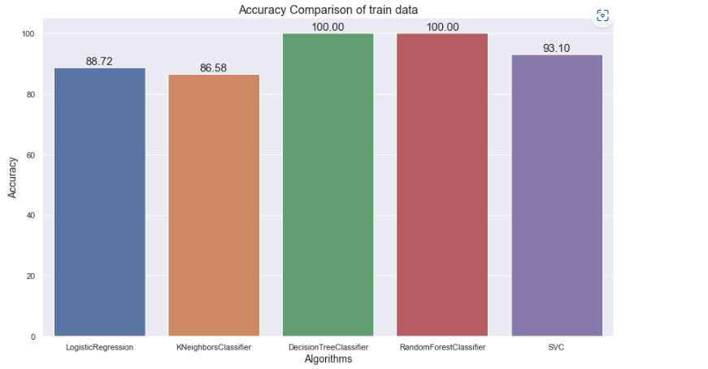
Accuracy Comparison Training Dataset

Slide 20
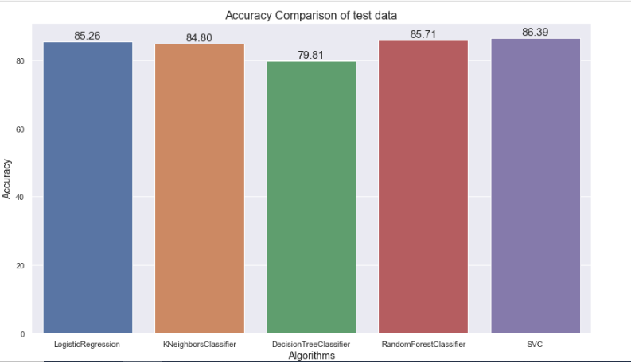
Accuracy Comparison
Based on the accuracy and other performance metrics, it appears that the Support Vector Machine (SVM) model may be slightly better than the Random Forest model for this dataset.
The SVM model had a higher accuracy and higher AUC, indicating better overall performance.
Thank You

